Slide 1
Lecture_05

Slide 2
X_CBSE_2017-18_Mod-19
Module_23

Slide 3





Classes must be continuous.
M
M
E
E
D
D
I
I
A
A
N
N
n
–
c.f
=
l
2
+
× h
f

Slide 4
n
–
c.f
Median =
2
× h
l
+
f
l = Lower limit of median class
n = Total frequency
c.f. = Cumulative frequency of class preceding the median class
f = Frequency of median class
h = Width of the class
Total frequency (N)
Steps :
(i)
Find the value of
= x
2
(ii) Check the ‘Cumulative frequency less than type’
coloumn for the value x
(iii) The cumulative frequency less than type which is
just greater than or equal to x. The corresponding
class is the median class.

Slide 5
Exercise 14.3 – Q.5
14.3(5)The following table gives the distribution of the life time of 400 neon lamps :
Life time (hours) | 1500 - 2000 | 2000 - 2500 | 2500 – 3000 | 3000 - 3500 | 3500 - 4000 | 4000 - 4500 | 4500 - 5000
No. of lamps | 14 | 56 | 60 | 86 | 74 | 62 | 48
Find the median life time of a lamp.
∴
Median class is 3000-3500.
Changing the data in continuous form
h
f
Sol:
=
500 ,
=
86 ,
c.f.
130
=
14
l
=
3000 ,
+
56
=
Class
Frequency
c. f.
70
70
+
n
-
60
=
130
c. f.
1500 - 2000
14
14
Median
2
×
h
l
+
=
2000 - 2500
56
70
f
2500 – 3000
60
130
←
c. f.
200
3000 – 3500
86
←
f
216
-
130
=
3000
+
290
Which c.f is greater than
or equal to 200
86
3500 - 4000
74
4000 - 4500
62
352
17500
48
400
=
3000
+
4500 - 5000
43
Total
n
=
400
=
3000
+
406.98
n
400
Here
=
=
200
∴
Median
=
hrs.
2
2
3406.98
Which lies in the class 3000 - 3500

Slide 6
X_CBSE_2017-18_Mod-20
Module_24

Slide 7
Exercise 14.3 – Q.4
14.3(4) The lengths of 40 leaves of plant are measured correct to the nearest millimeter, and the data obtained is represented in the following table
Length (in mm )
Number of leaves
(Hint: The data needs to be converted to continuous classes for finding the median , since the formula assumes continuous classes . The classes then change to 117.5 – 126.5,126.5 – 135.5,……..171.5 – 180.5.)
118 - 126
3
127 - 135
5
136 – 144
9
145 – 153
12
154 - 162
5
163 - 171
4
172 - 180
2
Find the median length of the leaves.
Find the median length of the leaves.
What do we need to find ?
Sol:
Let us change the data in continuous form
Is it a continuous class ?
NO

Slide 8
Exercise 14.3 – Q.4
Sol:
3
+
5
=
8
Class
f
c. f.
8
+
9
=
17
117.5 – 126.5
3
3
126.5 – 135.5
5
8
135.5 – 144.5
9
17
←
c. f.
144.5 – 153.5
12
←
f
29
153.5 – 162.5
5
34
162.5 – 171.5
4
38
20
-
17
=
144.5
+
×
9
171.5 – 180.5
2
40
12
Total
n
=
40
3
n
40
=
144.5
+
×
9
Here
=
=
Cumulative frequency of
The class preceeding the
Median class (c.f.)
12
20
Which lies in class 144.5 – 153.5.
2
2
Now identify the cumulative frequency which is greater than
or equal to 20
4
∴
Median class is 144.5 -153.5.
9
2.25
l
=
144.5
+
144.5 ,
h
9 ,
f
c.f.
=
=
12 ,
=
=
17
4
n
-
c. f.
=
144.5
+
2.25
Median
l
+
2
×
=
h
f
∴
Median
=
146.75
mm

Slide 9
X_CBSE_2017-18_Mod-21
Module_25

Slide 10
Exercise 14.3 – Q.3
14.3(3)A life insurance agent found the following data for distribution of age
of 100 policy holders. Calculate median age, if policies are given only to the
persons having age 18 years onwards but less than 60 years.
Age (in years) | Below 20 | Below 25 | Below 30 | Below 35 | Below 40 | Below 45 | Below 50 | Below 55 | Below 60
Frequency | 2 | 6 | 24 | 45 | 78 | 89 | 92 | 98 | 100
Age (in years)
Class
Cuml. frequency
Frequency
Below 20
15 - 20
2
2
Below 25
20 - 25
6
6 – 2 = 4
Below 30
25 - 30
24
24 – 6 = 18
Below 35
30 - 35
45
45 – 24 = 21
Below 40
35 - 40
78 – 45 = 33
78
f
Below 45
40 - 45
89
89 – 78 = 11
Below 50
45 - 50
92
92 – 89 = 3
Below 55
50 - 55
98
98 – 92 = 6
Below 60
55 - 60
100
100 – 98 = 2

Slide 11
Exercise 14.3 – Q.3
Class
frequency
Cum. frequency
n
-
c. f .
2
2
Median
=
l +
2
×
h
15 - 20
Cumulative frequency of the class preceeding the median class (c.f.)
Which c.f just greater than or equal to ?
20 - 25
6 – 2 = 4
6
f
50
25 - 30
24 – 6 = 18
24
50
-
=
35
+
45
30 - 35
45 – 24 = 21
45
c.f
×
5
33
78 – 45 = 33
78
35 - 40
f
25
0.76
40 - 45
89 – 78 = 11
89
=
35
+
33
45 - 50
92 – 89 = 3
92
=
35
+
0.76
50 - 55
98 – 92 = 6
98
Median
=
55 - 60
100 – 98 = 2
100
35.76
n
100
Here
=
= 50
which line in the class 35 - 40
2
2
Median class is 35 - 40
l = 35,
h = 5,
f = 33,
c.f. = 45,

Slide 12
Additional_Example
RD – 15.35 - Level-2 – Q12
Module_26

Slide 13
12
If the median of the following frequency distribution is 28.5 find the missing frequencies:
(4 marks)
Class interval
0 - 10
10 - 20
20 - 30
30 - 40
40 - 50
50 - 60
Total
Frequency
5
f₁
20
15
f₂
5
60
Sol.
Class intervals (Daily working hours)
Frequency (No. of workers)
Cumulative frequency (less than type)
0 - 10
5
5
10 - 20
f₁
+
5 + f₁
5
+
f₁
20 - 30
20
+
25 + f₁
5 + f₁
+
20
= 25 + f₁
15
+
25 + f₁
+
15
= 40 + f₁
30 - 40
40 + f₁
f₂
+
+
40 - 50
40 + f₁ + f₂
40 + f₁
f₂
50 - 60
5
+
45 + f₁ + f₂
+
40 + f₁ + f₂
5
Total
N =
60
= 45 + f₁ + f₂

Slide 14
12
If the median of the following frequency distribution is 28.5 find the missing frequencies:
(4 marks)
Class interval
0 - 10
10 - 20
20 - 30
30 - 40
40 - 50
50 - 60
Total
Frequency
5
f₁
20
15
f₂
5
60
Sol.
Class intervals (Daily working hours)
Frequency (No. of workers)
Cumulative frequency (less than type)
30
∴
N
60
=
30
Here N =
=
60
2
2
1
0 - 10
5
5
Median =
28.5
Which is lies in the class 20-30
10 - 20
f₁
5 + f₁
c.f
∴
l
=
20,
c.f.
=
5
+
f₁ ,
f
=
20,
h
=
10
20 - 30
20
25 + f₁
N
– c.f.
30 - 40
15
40 + f₁
2
40 - 50
f₂
40 + f₁ + f₂
Median =
l +
f
h
50 - 60
5
45 + f₁ + f₂
30
–
(5 + f₁)
Total
N =
60
28.5
=
20
+
20
×
10

Slide 15
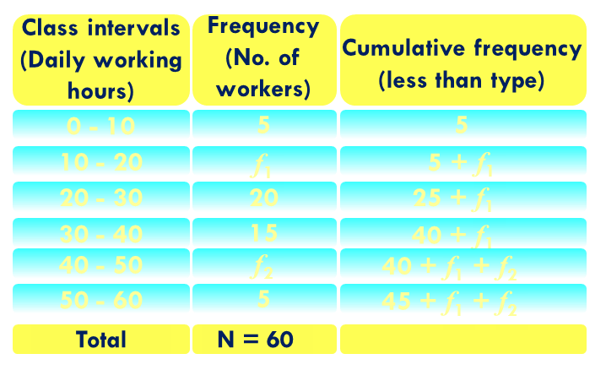
12
If the median of the following frequency distribution is 28.5 find the missing frequencies:
(4 marks)
Class interval
0 - 10
10 - 20
20 - 30
30 - 40
40 - 50
50 - 60
Total
Frequency
5
f₁
20
15
f₂
5
60
30
–
(5 + f₁)
Sol.
–
+
28.5
=
20
+
20
×
10
30
–
5
–
f₁
∴
28.5
=
20
+
2
25
–
f₁
∴
28.5
=
20
+
2
∴
f₂
=
15
–
f₁
25
–
f₁
=
15
–
8
=
7
∴
28.5
–
20
=
2
∴
45
+
f₁ + f₂
∴
=
60
8.5
×
2
=
25
–
f₁
∴
f₁ + f₂
=
60
–
45
∴
17
=
25
–
f₁
∴
f₁ + f₂
=
15
∴
–
f₁
Hence missing frequencies are 8 and 7.
∴
f₁
=
25
–
17
∴
f₂
=
15
∴
f₁
=
8

Slide 16
Additional_Example
RD – 15.36 - Level-2 – Q14
Module_27

Slide 17
14
If the median of the following data is 32.5, find the missing frequencies:
(4 marks)
Class interval
0 - 10
10 - 20
20 - 30
30 - 40
40 - 50
50 - 60
60 - 70
Total
Frequency
f₁
5
9
12
f₂
3
2
40
Sol.
Class intervals (Daily working hours)
Frequency (No. of workers)
Cumulative frequency (less than type)
0 - 10
f₁
f₁
10 - 20
5
+
5 + f₁
5
+
f₁
20 - 30
9
+
14 + f₁
5 + f₁
+
9
= 14 + f₁
12
+
14 + f₁
+
12
= 26 + f₁
30 - 40
26 + f₁
f₂
+
+
40 - 50
26 + f₁ + f₂
26 + f₁
f₂
50 - 60
3
+
29 + f₁ + f₂
+
26 + f₁ + f₂
3
+
= 29 + f₁ + f₂
+
60 - 70
2
31 + f₁ + f₂
29 + f₁ + f₂
2
= 31 + f₁ + f₂
Total
N =
40

Slide 18
14
If the median of the following data is 32.5, find the missing frequencies:
(4 marks)
Class interval
0 - 10
10 - 20
20 - 30
30 - 40
40 - 50
50 - 60
60 - 70
Total
Frequency
f₁
5
9
12
f₂
3
2
40
Sol.
Class intervals (Daily working hours)
Frequency (No. of workers)
Cumulative frequency (less than type)
20
∴
N
40
=
20
Here N =
=
40
2
2
0 - 10
f₁
f₁
1
Median =
32.5
Which is lies in the class 30-40
10 - 20
5
5 + f₁
∴
l
=
30,
c.f.
=
14
+
f₁ ,
f
=
12,
h
20 - 30
9
14 + f₁
c.f
=
10
30 - 40
12
26 + f₁
N
– c.f.
40 - 50
f₂
26 + f₁ + f₂
2
Median =
l +
f
h
50 - 60
3
29 + f₁ + f₂
60 - 70
2
31 + f₁ + f₂
20
–
(14 + f₁)
32.5
=
30
+
12
×
10
Total
N =
40

Slide 19
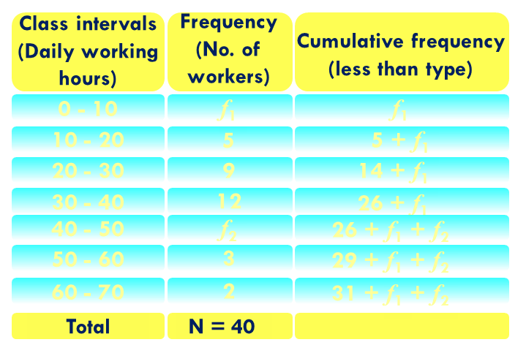
14
If the median of the following data is 32.5, find the missing frequencies:
(4 marks)
Class interval
0 - 10
10 - 20
20 - 30
30 - 40
40 - 50
50 - 60
60 - 70
Total
Frequency
f₁
5
9
12
f₂
3
2
40
Sol.
20
–
(14 + f₁)
–
+
32.5
=
30
+
12
×
10
20
–
14
–
f₁
∴
32.5
–
30
=
×
10
12
6
–
f₁
∴
2.5
=
×
10
12
∴
f₂
=
9
–
f₁
2.5
∴
×
12
=
60
–
10f₁
=
9
–
3
=
6
∴
30
=
60
–
10f₁
∴
Hence missing frequencies are 3 and 6.
∴
31
+
f₁ + f₂
10f₁
=
60
–
30
=
40
∴
∴
f₁ + f₂
=
40
–
31
∴
10f₁
=
30
∴
f₁ + f₂
=
9
30
–
f₁
∴
f₁
=
=
3
∴
f₂
=
9
10

Slide 20
Thank You

